Slide 1
Principles of Concurrent
Systems - Processes
Multi-tasking using Time-Slicing
Design Methods for Multi-Tasking Systems
Multi-Tasking Concepts – Parent/Child Concept
Creating Parallel Processes: CProcess Class, rt.cpp, rt.h
A Detailed Look at Win32 Calls
Note: Examples of the concepts presented here can be found in the RTExamples folder: Q2
You are encouraged to open the project(s) in Visual Studio and run the program(s)
©Paul Davies 2020. Not to be copied, used, or revised without explicit written permission from the copyright owner. This lecture may contain animations and is best viewed as a slide show

Slide 2
Multi-tasking Systems Using Time Slicing and an Operating System
In the last lecture we looked at approaches to creating concurrency using
  Pseudo-Multitasking
  Multiple CPUs/Cores
  Distributed Computing
  Grid Computing/Clustering
A much more practical and cheaper approach is to make use of a Multi-Tasking Operating System (MTOS) in conjunction with a time-sliced CPU/Core.
How does this work?

Slide 3
Ideally, we would have a core for every thread in our system, but that is not practical, so when an OS runs out of cores, it resorts to time-slicing.
Time Slicing is an attempt to create concurrency by forcing a CPU/Core to swap rapidly between tasks. If the swapping is done frequently, it looks like all the tasks are executing at the same time.
Time-slicing works by dividing up a CPU’s processing power in 'packets' of time (called ‘time slices’) – typically between 1-10mS. The operating system then allocates these packets to programs or threads that are able to make use of them.

Slide 4
How is Time Slicing Implemented : Using a Real-Time Clock (RTC)
Time slicing occurs with the aid of a real-time clock (RTC) which generates interrupts (or ticks) to the CPU, typically every 1-10mS.
Each tick forces the CPU to pause execution of the current process/thread and switch its attention to another. We can see this in the animation below.
The swapping from one process/thread to another is called a ‘context switch’.
The OS keeps track of all task, and ensures their “state” is preserved when they are interrupted so they can be resumed later.
OS Kernel called to deal with Interrupt
Operating
System
Kernel
Operating
System
Kernel
Save State of Current Task
Restore State of Next Task
Interrupt Cleared
Real
Time
Clock
Real
Time
Clock
10ms interrupt
CPU
Kernel directs CPU to swap/resume task
List of Tasks Descriptors
(1 per task)
1
2
3
4
5
Active Process Queue
Repeat Forever

Slide 5
The illusion of concurrency can best be seen by considering an analogy with one of the old style digital clocks with LED displays.
By using time-division multiplexing, each display in turn can be enabled for maybe 10mS and the 7 segment lines changed to the data relevant for that display.
If this multiplexing is done sufficiently quickly, it gives the illusion, to the eye at least, that all displays are lit at the same time, however a high speed camera would tell another story.
This principle of rapidly swapping between displays to give the impression that all are active at the same time is exactly what a multi-tasking operating system is trying to achieve. So how is it managed?
7 Segment Display Lines
2
1
0
Enable 1
Enable 2
Enable 3
Enable 4

Slide 6
Notes about Time slicing
Note 1: Time-slicing is still an illusion. A single core within a CPU can only be running one task at any one instant in time. Of course with multiple cores, that potential processing power increases.
Note 2: Time-slicing is not the same as Pseudo Multi-tasking (see last lecture). In that case, we swapped between tasks (implemented as functions/subroutines) on a voluntary, co-operative basis. That is the tasks needed to be aware of each other and co-operate so as not to ‘hog’ all the CPU time. With time slicing, the cores are taken away from threads at unpredictable times and returned later so that they can carry on.
Note 3: You may think that a single core, time-slicing between 10 tasks means that each task will only run at 10% of its speed compared to the situation where it was the only task running on that core. That may be true if every task was attempting to fully utilise the core’s processing power e.g. each performing a complex mathematical calculation such a Machine Learning problem. The reality however is that many tasks (particularly those in a real time system) are not like that. They spend much of their time “idle” waiting for input. For example when you open “Microsoft Word”, apart from the time used to bring up the application, Word uses NO CPU TIME at all, since it only needs CPU time to process key presses as your type – if you are not typing, the OS does not schedule Word to receive time. If you opened 10 copies of word on your computer, your CPU Utilisation would still be virtually 0% – see next slide.

Slide 7
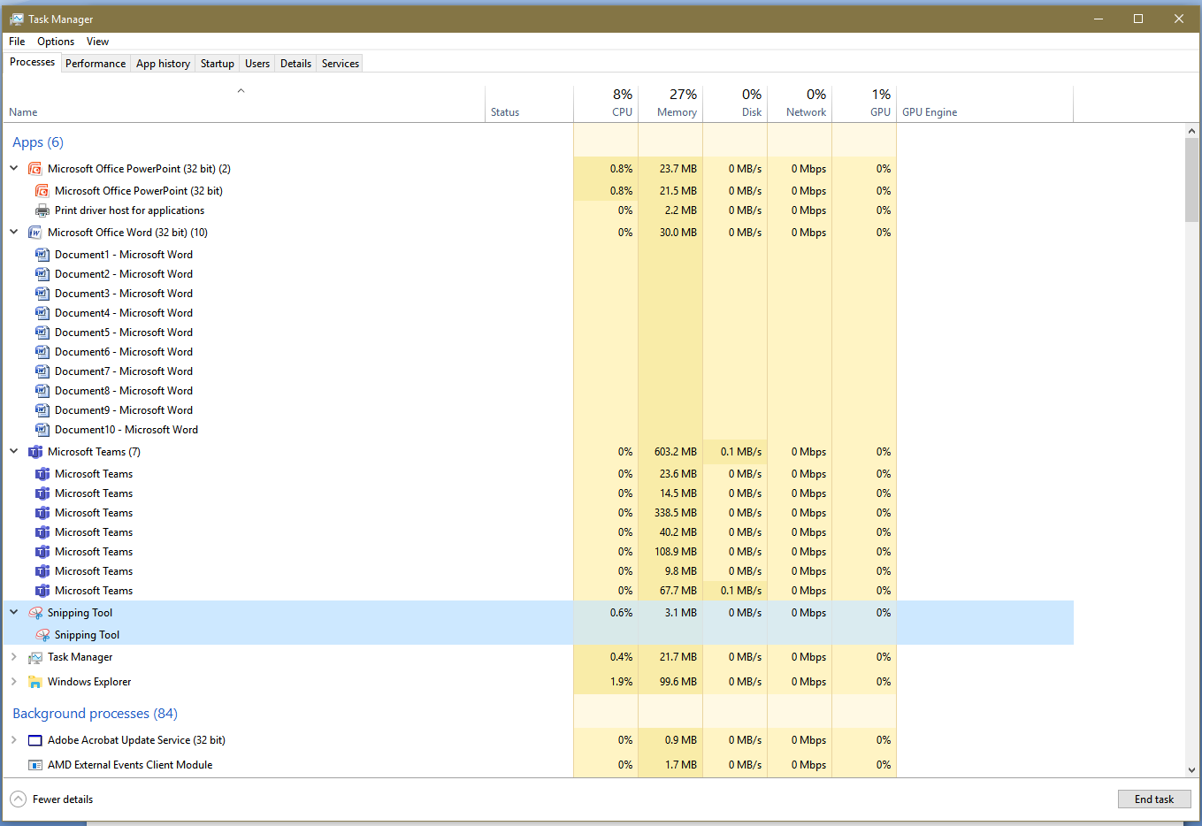
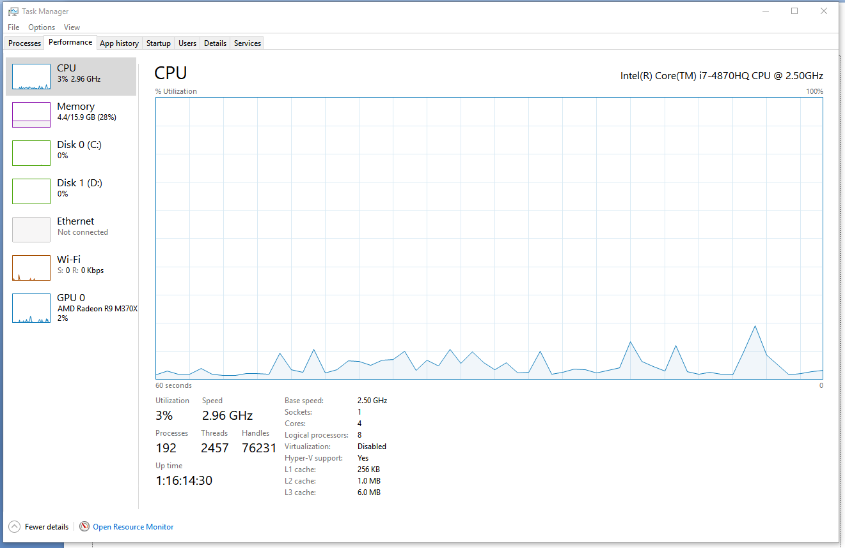
This is a snap shot of the task manager under windows (search for task manager). You can see 10x Word, 2x Powerpoint, 7x Teams, the Snipping tool and a Folder were open as well as 84 background tasks. Yet total CPU utilisation was only 8% and none of that was allocated to running Word. The graph also shows a real time trace of CPU utilisation. Conclusion – time-slicing works well for interactive programs.

Slide 8
What is an Operating System Kernel ?
A kernel is the heart of an operating system and is simply a collection of applications, services and “system calls” that implement such things as
  Creating tasks
  Scheduling and prioritisation of tasks,
  Managing resource sharing between tasks
  Task communication,
  Task synchronisation,
  Sharing memory (including protecting tasks from each other),
  Handling the GUI (windows, mouse, keyboard etc.)
  Dealing with files, directories, networks & other devices etc.
A kernel thus provides a set of services and system calls to the host programs that you or I write (remember fopen() for example).
That is, our programs can make calls to the kernel to request any of the above.

Slide 9
Question: How do we design Multi-tasking Systems?
Obviously, the fundamental difference between a single tasking and a multi-tasking (or concurrent) system is the fact that a multi-tasking system is designed to carry out several tasks at the same time.
Such tasks are integrated into our programs through the use of several co-operating processes or threads. (processes are complete programs, i.e. ‘.exe’ files, while threads are parallel executing sections of code within a process or .exe)
All other problems concerning concurrent systems design, arise directly as a result of the inclusion of these processes/threads into our solution, e.g. task communication, task synchronisation, resource sharing etc.
What tools do I need to design Concurrent Systems?
Ideally you would need
  A multi-tasking operating system kernel e.g. Win32/64 or Linux etc.
  A concurrent programming language.

Slide 10
Design then starts with hierarchical Process/Thread Decomposition
This is an attempt to break down one “big” program into a number of smaller identifiable tasks that will meet the concurrency, performance and scalability requirements of the system which will map efficiently to our chosen hardware platform (or dictate our chosen platform).
Question: What guidelines should the programmer use when decomposing a system into processes/threads. For example how many processes and threads should we create? Answer: The minimum we can get away with that meet our scalability and concurrency needs – basically it’s hard !!!
requests
EV Scheduler
EV Scheduler
Big
Monolithic
Single Tasking
System Elevator
commands
Big
Monolithic
Single Tasking
System Elavator
main()
{
}
main()
{
}
main()
{
}
main()
{
}
requests
Elevator 1
Elevator 2
Elevator 3
Elevator 4
From: Single-Tasking Elevator System
To: Multi-Tasking Elevator System

Slide 11
Use of Concurrent Programming Languages
Some programming languages such as
  Java,
  Occam,
  Ada
were designed at the outset to allow concurrency to be expressed in one form or another (although some are more natural than others).
Other programming languages have evolved to provide concurrency support through the use of libraries of function calls which make them easy to use.
Some are based on plain old ‘C’ code and thus are very low level, others are based on C++ classes (object oriented programming) and thus provide higher levels of abstraction, hiding away the “detail” of making kernel calls directly.

Slide 12
Using a Parallel Language Compiler

Slide 13
Concurrent Programming Language Extensions - PAR and SEQ
Using true concurrent programming languages greatly simplifies the design of concurrent systems.
Many use some variation of ‘PAR’ (parallel) and ‘SEQ’ (sequence) to express both parallel and sequential actions within a task.
For example in Occam we could write programs to look like this.
PAR
SEQ // Process 1
. . . // Program code for process 1
. . .
SEQ // Process 2
. . . // Program code for process 2
. . .
SEQ // Process 3
. . . // Program code for process 3
. . .
PAR END
Homework Exercise: Express ((-b) +/- sqrt(b² – 4ac))/(2a) using PAR and SEQ for maximum parallelism
3 Sequences executed in Parallel
(see http://en.wikipedia.org/wiki/Occam_programming_language)

Slide 14
The use of language features such as ‘PAR’ and ‘SEQ’ makes life simple for the programmer but hides what happens within the compiler.
For example, a compiler might have to translate the ‘PAR’ section in our code, into separate concurrent tasks (e.g. threads) plus a main() to call the kernel to start those threads at run time.
After First Pass Compilation
void Thread1( ) {
Statement A
Statement B
}
Original Source Code
PAR
SEQ
Statement A
Statement B
SEQ
Statement C
Statement D
SEQ
Statement E
Statement F
PAR END
Parallel
Language
Compiler
void Thread2( ) {
Statement C
Statement D
}
From
To
void Thread3( ) {
Statement E
Statement F
}
int main( ) {
CreateThread( Thread1 ) ;
CreateThread( Thread2 ) ;
CreateThread( Thread3 ) ;
}

Slide 15
The function main() thus calls the OS kernel to create the 3 threads. The OS then schedules them using available cores and/or time slicing.
In other words the choice of allocating threads to CPUs and Cores is made by the operating system, which can then perform load balancing to distribute the work as fairly as possible amongst the CPUs and cores.
Program begins here
void Thread1( ) {
Statement A
Statement B
}
Scheduling
OS Kernel
e.g. Linux
or Win32
+ Multi Core
CPU
int main() {
CreateThread( Thread1 ) ;
CreateThread( Thread2 ) ;
CreateThread( Thread3 ) ;
}
void Thread2( ) {
Statement C
Statement D
}
CreateThread() is a direct Windows OS Kernel call to create threads
Three hidden calls to the OS Kernel requesting it to create and schedule 3 threads
void Thread3( ) {
Statement E
Statement F
}

Slide 16
Using a Conventional (Non-Parallel) Programming Language
-
Making Native OS calls and Translation Libraries

Slide 17
In conventional sequential languages like ‘C/C++’, we have to make those Operating System (OS) calls explicitly, to create our processes and threads. That is, we have to become Systems Programmers and familiarise ourselves with a specific kernel, its system calls and libraries. For example UNIX system calls are very different to Windows
We thus have to do the job of the parallel language compiler and create our parent/child tasks with the processes and threads already explicitly identified within the code and construct our own overall main() to pull it all together to control the creation of the tasks at run time.
Parent Process
Child Processes
Parent Code.c
Scheduling
void main() {
…
…
}
void main()
{
CreateEnvironment() ;
fork( child1 ) ;
fork( child2 ) ;
fork( child3 ) ;
ParentAction() ;
wait( child1 ) ;
wait( child2 ) ;
wait( child3 ) ;
RemoveEnvironment()
}
System calls
OS Kernel
e.g. Linux
or Win32
+ Multi Core
CPU
Child Code1.c
void main() {
…
…
}
Child Code2.c
System calls
void main() {
…
…
}
fork() and wait() are Direct UNIX OS Kernel calls to create processes
Child Code3.c

Slide 18
Drawbacks to this approach
Placing direct OS calls into our programs makes it difficult to ‘port’ (i.e. recompile and run) the application under a different OS.
Solving Portability using a Translation Library
To overcome this problem, most programmers place the explicit kernel calls into an “App-To-OS” translation library. Portability is improved, as you only have to rewrite the library not the application when changing to a new OS (see supplement at slide 30).
Child Processes
Parent Process
Parent Code.c
Scheduling
void main() {
…
…
}
#include “rt.h”
void main()
{
CreateEnvironment() ;
CProcess p1( “child1.exe” ) ;
CProcess p2( “child2.exe” ) ;
CProcess p3( “child3.exe”) ;
ParentAction() ;
p1.WaitForProcess( ) ;
p2.WaitForProcess( ) ;
p3.WaitForProcess ( ) ;
RemoveEnvironment() ;
}
RT
Library
RT
Library
OS system call Fork(), Create Thread() etc.
Child Code1.c
OS Kernel
void main() {
…
…
}
Application Call
Child Code2.c
OS system call Fork(), Create Thread() etc.
void main() {
…
…
}
Translation Layer
Child Code3.c

Slide 19
Creating and Controlling
Processes
via the RT Library
-
The CProcess Class

Slide 20
Simple Concurrency using Processes: The RT Library CProcess() class
A process is defined as any self contained program running under an OS, e.g. editor, compiler.
The same program could be run multiple times on the system creating multiple processes based on a single copy of the executable program stored in memory.
Creating processes with the rt.cpp library is easy. You only have to create an instance of a CProcess class. The constructor in the CProcess class makes the (hidden) OS system calls to create the process and its input/output window.
The example below shows a single ‘Parent’ process that creates three ‘child’ processes by creating three instances of the CProcess class, i.e. objects p1, p2 and p3. The ‘…’ will be explained shortly.
void main()
{
CreateEnvironment( ) ; // create environment for child processes to run
CProcess p1("Pathlist1", . . . ) ; // create a child process object and call Kernel
CProcess p2("Pathlist2", . . . ) ; // create a child process object and call Kernel
CProcess p3("Pathlist3", . . . ) ; // create a child process object and call Kernel
ParentTask() ; //other actions carried out by this parent process
// that run concurrently with the child processes
p1.WaitForProcess( ) ; // wait for child process p1 to terminate
p2.WaitForProcess( ) ; // wait for child process p2 to terminate
p3.WaitForProcess( ) ; // wait for child process p3 to terminate
RemoveEnvironment( ); // remove environment
}
Parent Process

Slide 21
The CProcess Class Member Functions
The CProcess class also contains a number of member functions to control the child processes.
These member functions are outlined below with a brief description of what they do. They are called by the parent process to influence the operation of the child process in some way.
A detailed implementation of them can be found in the rt.h and rt.cpp files on the course web-site.
CProcess( ) - The constructor responsible for calling the Kernel.
Suspend( ) - Suspends a child process effectively pausing it.
Resume( ) - Wakes up a suspended child process.
SetPriority( ) - Changes the priority of a child process
Post( ) - Posts a message to a child processes (see later lecture).
TerminateProcess( ) - Terminates or Kills a child process (potentially dangerous) .
WaitForProcess( ) - Pauses the parent process until a child process terminates.
If the child has already terminated, the parent will not wait.
Member Functions of the CProcess Class

Slide 22
A detailed look at the CProcess constructor
The CProcess class constructor is responsible for:-
  Invoking the operating system kernel to ask it to run a program as a new process.
  Assigning a Priority to the process relative to all other processes in the system.
  Assigning a Window to the process in which the programs I/O will interact.
  Assigning it a run state: Suspended or Running.
A breakdown of an example function call/usage is given below. It takes 4 parameters
CProcess p1("Pathlist arg1 arg2", Priority, WindowType, RunState ) ;
Pathlist to executable ‘.exe’ file plus any arguments passed to process as strings
Process Priority: NORMAL_PRIORITY_CLASS
Window Type: OWN_WINDOW or PARENT_WINDOW
Window Type: OWN_WINDOW or PARENT_WINDOW
Run State: ACTIVE or SUSPENDED

Slide 23
Example Parent Program passing string args to a child (see tutorial Q1 problem) and controlling the execution of parent and child process
#include “rt.h”
int main()
{
CProcess p1( "c:\\users\\child1.exe arg1 arg2", // pathlist to '.exe.' file + 2 optional args
NORMAL_PRIORITY_CLASS, // a safe priority level
OWN_WINDOW, // process uses its own window
ACTIVE // create process in running/active state
) ;
. . .
. . .
// now lets control that process via the object p1
. . .
. . .
SLEEP(2000) ; // Suspend the parent for 2 seconds
p1.Suspend( ) ; // suspend the child process
SLEEP(2000) ; // Suspend the parent for 2 seconds
p1.Resume( ) ; // resume the child process
p1.WaitForProcess( ) ; // pause parent until child terminates
} ;
Spaces are used to separate “pathlist to executable” from any optional arguments that we choose to pass to child process, so make sure your windows pathlist does not contain any spaces
Why suspend parent before attempting to control the child process?

Slide 24
Example Child Program printing out the string args received from Parent (see Q1 problem)
#include “rt.h”
int main( int argc, char *argv[ ] ) // declare child process main() like this to pick up args
{
// get number of arguments, the first argument is always the path list/name of the program
// so argc will always be at least 1. All arguments are passed as strings, so you have
// to do any conversion required to convert them to say integers, or floats etc (see
// function atoi() and atof() in the C/C++ standard library
cout << "argc count = " << argc << "\n" ;
// print out the arguments as strings, 1st arg (i.e. argv[0]) is a string containing pathlist/name
// of program, 2nd arg (i.e. argv[1]) is a string containing 1st optional arg passed by parent
for( int i = 0; i < argc; i ++) // set up loop to print out all args
cout << "argv[ " << i << "] = " << argv[i] << "\n" ;
} ;

Slide 25
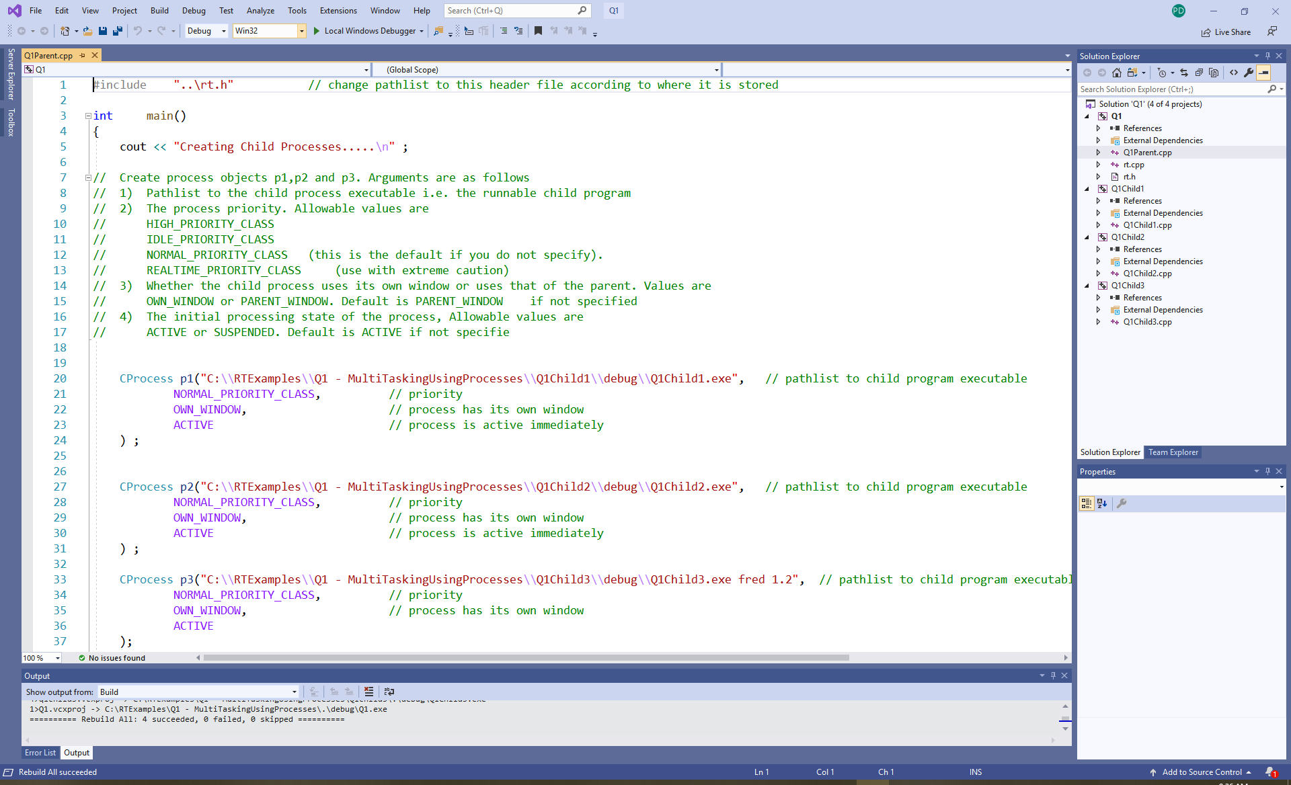
Open Q1 from the RTExamples folder – Make sure you rebuild the 4 projects inside

Slide 26
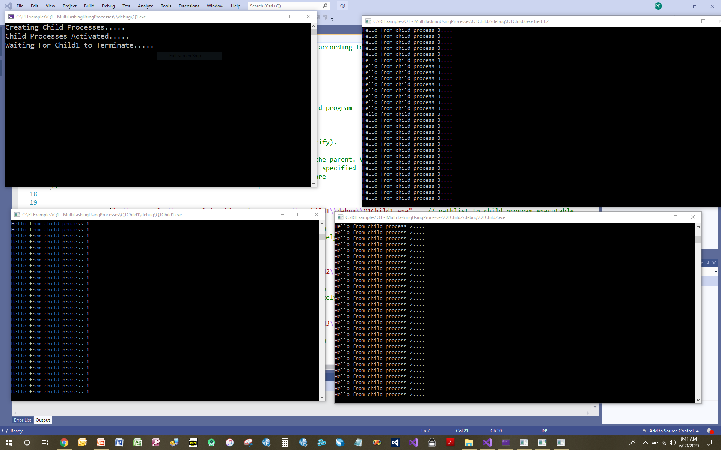
Run the program and you should see 4 windows open – 1 per process. Experiment with the program – we’ll do something similar as part of a Lab

Slide 27
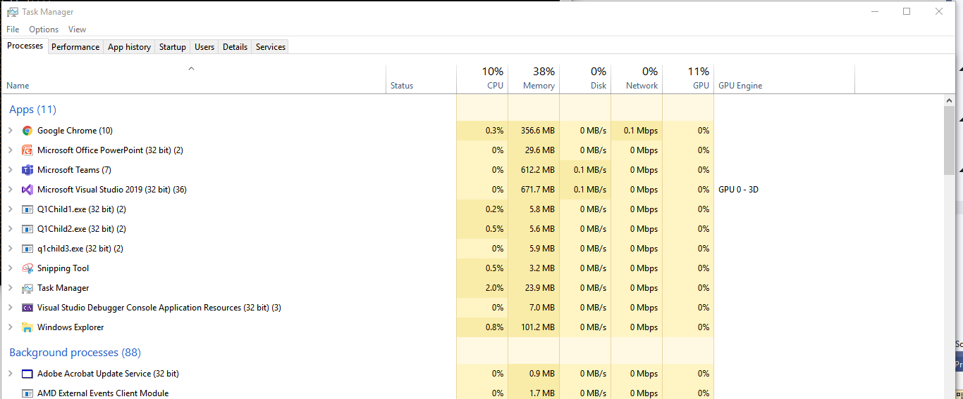
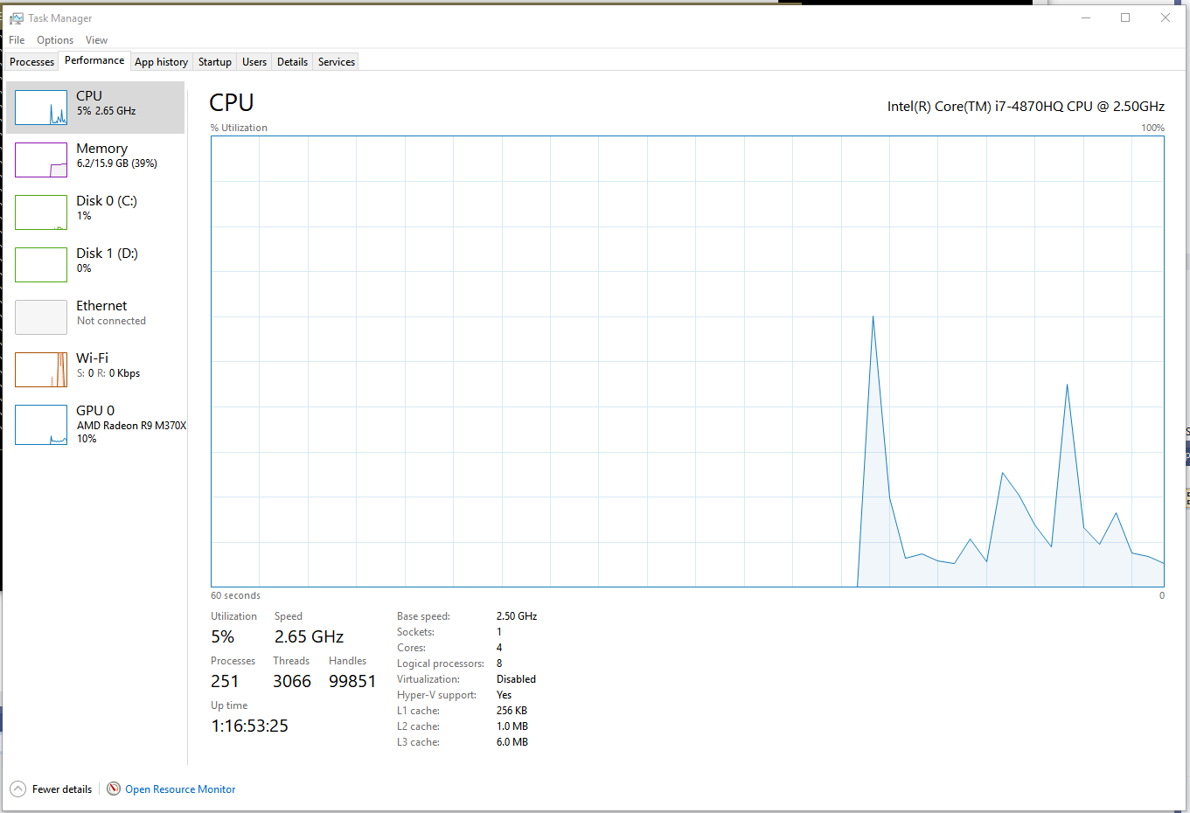
Here’s the task manager “snap shot” when the programs are running. They are still not using much CPU time because of the multiple Sleep() calls each process has inside it.

Slide 28
How Does CProcess() Work?
The code for the CProcess constructor is shown below and calls the Windows Kernel to create the new process. As you can see, it is quite detailed.
If the rt.cpp library did not exist, you would have to write this code for yourself in your programs each time you wanted to create a new process.
CProcess :: CProcess( const string &Name, int Priority, BOOL bUseNewWindow, BOOL bCreateSuspended) : ProcessName(Name)
{
// a data structure needed for the Kernel Call to control console window appearance and position
STARTUPINFO StartupInfo = {
sizeof (PROCESS_INFORMATION) ,
NULL , // reserved
NULL , // ignored in console applications
(char *)(Name.c_str()) , // displayed in title bar for console applications
0,0, // dwx, dwy, offset of top left of new window relative to top left of screen in pixel
// flags below must specify STARTF_USEPOSITION. Ignored for console apps'
0,0, // dwxsize, dwysize: Width and height of the window if new window specified
// must use flags STARTF_USESIZE. Ignored for console apps'
0,0, // size of console in characters, only if STARTF_USECOUNTCHARS flag specified,
// Ignored for console apps
0, // Colour control, for background and text. Ignored for console apps
0, // Flags. Ignored for console applications
0, // ignored unless showwindow flag set
0 ,
NULL,
0,0,0 // stdin, stdout and stderr handles (inherited from parent)
} ;
. . .
Google “getconsolewindow” for list of function to manipulate the window after it has been made, e.g. size, colour etc.
Cont…

Slide 29
See https://docs.microsoft.com/en-gb/windows/desktop/ProcThread/creating-processes
UINT flags = Priority ; // new Process Priority,
if( bUseNewWindow == OWN_WINDOW) // if parent has specified child should have its own window
flags |= CREATE_NEW_CONSOLE ; // bit wise “OR” flags with CREATE_NEW_CONSOLE
if( bCreateSuspended == SUSPENDED) // if parent has specified child process should be suspended
flags |= CREATE_SUSPENDED ; // bit wise “OR” flags with CREATE_SUSPENDED
/////////////////////////////////////////////////////////////////////////////////////////////
// Call to Windows Kernel to create the child process takes place here in the constructor function
/////////////////////////////////////////////////////////////////////////////////////////////
BOOL Success = CreateProcess(
NULL, // application name
(char *)(Name.c_str()), // Optional command line to pass to process main() (or NULL)
NULL, // process attributes
NULL, // thread attributes
TRUE, // inherits handles of parent
flags, // Priority and Window control flags,
NULL, // use environment of parent
NULL, // use same drive and directory as parent
&StartupInfo , // controls appearance of process (see above)
&pInfo // Stored process handle and ID into this object
);
// Save information about the new process inside the CProcess class (member variables) so we can control the process later
// These variables are declared in the rt.h file
ProcessHandle = pInfo.hProcess ; // handle to the child Process, can be used to identify a process
ThreadHandle = pInfo.hThread; // handle to the child process's main thread, used to identify thread
ProcessID = pInfo.dwProcessId ; // Id of the Child Process (not the same as a handle)
ThreadID = pInfo.dwThreadId; // Id of the Child Process's main thread (not the same as a handle)
}

Slide 30
Supplement
-
Examples of
Concurrency
Libraries

Slide 31
POSIX Threads Library – pThreads
Origins lie with Unix, so features of other OS’s e.g. Windows not likely supported
https://www.cs.cmu.edu/afs/cs/academic/class/15492-f07/www/pthreads.html
https://computing.llnl.gov/tutorials/pthreads/
Non object oriented - Based around ‘C’ code and function calls, no C++ features.
Windows programmers can download “Cygwin” (www.cygwin.com/ ) which is a POSIX-compatible environment that runs natively under Microsoft Windows allowing POSIX code to be re-compiled and run in that environment under a Windows OS. The C compiler for NIOS II CPU (built into Quartus) requires a Cygwin environment.
Very easy to pick up POSIX within a day or two of completing this course – most of the features we discuss in this course are there, but some are not.

Slide 32
Concurrent C++ Language extensions
C++ Standards committee attempted to extend the C++ language to provide native/compiler support for thread based concurrency, starting with C++ ’11 but was extremely immature.
Those language extensions only supported concepts that were cross platform (it’s a language after all, so it has to run on all machines, independent of OS). To access thread related features unique to a specific OS, you would have to fall back on making direct calls to the kernel e.g. creating processes for example (not supported C++ 11).
C++ 14 and 17 added more thread concepts to the language. C++ 20 is proposing even more, such as barriers and the rendezvous (both built into RT Library).
https://thispointer.com/c-11-multithreading-part-1-three-different-ways-to-create-threads/
http://www.modernescpp.com/index.php/multithreading-in-c-17-and-c-20
This guy (https://www.youtube.com/watch?v=LL8wkskDlbs) has produced some good YouTube videos on this topic.
Concurrent C++ has some nice features, it’s standardized and it’s object oriented, but it is initially quite hard to use as some of the advanced features require a complex and complete understanding of the C++ language e.g. templates, containers, inheritance.
After completion of this course, the C++ extensions for concurrency would be easy to pick up – we’ll show some of them along the way for comparison.

Slide 33
Boost Libraries
Another library that is gaining traction in the world is Boost
https://www.boost.org/doc/libs/1_66_0/doc/html/thread.html
This seems a very complete and advanced Object Oriented approach with some nice/clever features provided you have an excellent grounding in C++ (which may not be the case right now for many students in CPEN 333). However if that is a direction you see yourself going, it is not too difficult to translate the concepts and code examples we learn in this class into Boost code.
Remember all libraries and language extensions ultimately translate code into calls to the host OS Kernel, so they are not magic, most just present higher levels of abstraction to make it easier to program. Some target a host OS with features that map nicely, but there is no “one size fits all” library.
My advice is to learn the principles of concurrency first and then migrate to one of these libraries/language extensions later as your confidence grows, otherwise, you will be fighting application development on two fronts – concurrency and advanced C++ concepts.
The RT library introduces you to concurrency in an easy to understand way so you can focus on the concepts and if required, migrate these to these other libraries later.

Slide 34
The RT Library
This C++ library was re-written for a windows environment by your instructor back in 2003 and has been evolving ever since.
The aim was to build a powerful library of C++ classes that could be used for teaching, i.e. make it easy to understand and build concurrent, multi-threaded applications using an object oriented approach, so you can focus on the concepts not a complex syntax.
The library targets the Windows Kernel only – but could be ported to other OS’s with a little work (in fact it actually started off in Unix style environment prior to 2003), but as most students had Windows machines, it made sense to support that OS.
The library implements all common requirements for multi-threaded applications, e.g. threads, processes, synchronisation, communication etc. Many of my ex-students have (and still do) use it in industry. For instance it’s had many of the C++ ‘20 features since 2003.
Source code is available as a learning exercise. (see the rt.cpp and rt.h files)

